Slide 1
Design of Software Systems CS 509
Fall 2022 - Hybrid
Prof. George Heineman
WPI
heineman@cs.wpi.edu

Slide 2
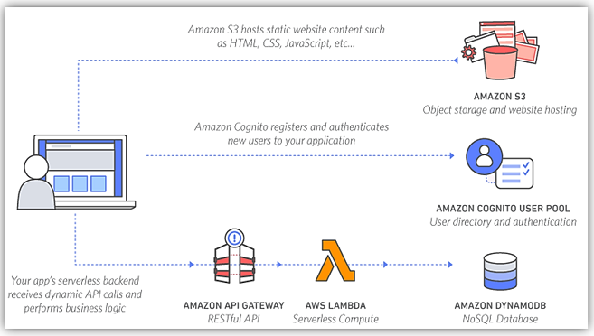
Last Lecture Recap And Outline
Lecture Recap
Definition of an Interface
Intermediate WebServices architecture
Tonight
Lambda Services
Walk through AWS Code
HTTP and requests
Description of building blocks for group project application
HW1.Code and HW1.Test due October 7th

Slide 3
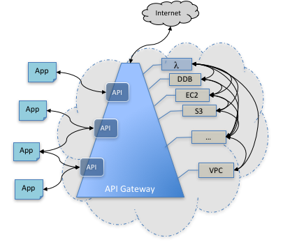
API Gateway
API offers the ability to connect AWS services together
Consistent RESTful application programming interface (API)
Lambda Expressions offer raw computation
We need to knit these individual computations together to form larger application

Slide 4
REST Architectural Style
Representational State Transfer [link]
Principled Design of the Modern Web Architecture [URL]
Review page 8 for issues with implementation of HTTP 1.x
Representation metadata does not compose
Cookies violate the notion of application state
Fundamentally client/server
Stateless
Request from client contains all information to service request
Session state is held in the client [can be stored on server]
Client initiates request and is “in transition” until response
Representation of application state in response contains embedded links for next time
Responses may be cached [unless marked no-cache]

Slide 5
Managing State in Browser Application
Applications need to store persistent state somewhere
You may be aware of browser-based storage
window.localStorage.setItem(key, value);
let result = window.localStorage.getItem(key);
window.localStorage.removeItem(key);
But this is only on the client side
What about cookies?
You may know how these are stored on the client and sent to and from a server

Slide 6
HTTP State Management (RFC)
Origin server sends state in HTTP Response Header
Set-Cookie header field
Set-Cookie: SID=31d4d96e407aad42
Browser subsequently includes in each HTTP Request Header to “same origin”
Cookie: SID=31d4d96e407aad42
Multiple cookies can be sent
Proscribed limits:
At least 4096 bytes per cookie (as measured by the sum of the length of the cookie's name, value, and attributes)
At least 50 cookies per domain
At least 3000 cookies total
Practical limits: 4K for ALL cookie information

Slide 7
Cookie Examples
Cookies accrue over time
Multiple cookies can be included in same response
Set-Cookie: SID=31d4d96e407aad42; Path=/; Secure; HttpOnly Set-Cookie: lang=en-US; Path=/; Domain=example.com
Server initiates removal of cookies
Set-Cookie: lang=en-US; Expires=Wed, 09 Jun 2021 10:18:14 GMT
Use date “in the past” and Browser removes cookie
Client can autonomously remove cookies from cache
Browsers typically deny cookies once space exceeded

Slide 8
Cookie Domain and Path Attribute
Server specifies domain attribute
Hosts to which the cookie is sent
Value of “example.com” means cookies are included to example.com, www.example.com, and www.corp.example.com
Client must interpret domain attribute correctly and safely
Must reject cookies if domain value does not include origin server
Accept from foo.ex.com ex.com or foo.ex.com
Reject from foo.ex.com bar.ex.com or baz.foo.ex.com
Scope of each cookie is limited to a set of paths
If omitted, user-agent will use URI path
Turns out that this feature not entirely useful

Slide 9
Cookies Have Security Weaknesses
Ambient Authority
Cookies encourage server operators to separate designation (URL) from authorization (cookie)
User agent might supply authorization for resource designated by an attacker (causing server to execute actions as if they had been authorized by the user)
Clear Text
Without SSL encryption all information is sent in clear text
Malicious intermediary could alert request or response headers
Weak Integrity
Overlapping subdomains (a.b.com and x.b.com) could both set cookies in the b.com domain which might interfere with each other
Enables potential attack of compromised cookies

Slide 10
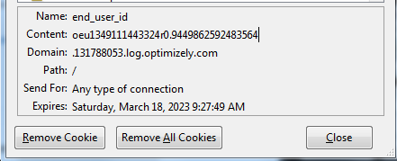
Cookies Have Privacy Concerns
Third-Party Tracking Cookies
User Controls
Expiration Dates
Gratuitously long expiration dates

Slide 11
Using HTTP as Application Protocol
AWS has set up a sample “petstore” application
https://docs.aws.amazon.com/apigateway/latest/developerguide/api-gateway-create-api-from-example.html
Use default HTTP capabilities to advance application
Envision all state changes by means of GET and POST
GET – retrieve a collection of information
http://petstore-demo-endpoint.execute-api.com/petstore/pets
GET – retrieve a specific piece of information
http://petstore-demo-endpoint.execute-api.com/petstore/pets/1
POST – update request
This is a bit more complicated….

Slide 12
Add A New Pet
Response
Has Request and Header and Body
POST sends data using a number of techniques
Here JSON encoding is used
Mock Interfaces
This available service is not connected to any real back-end so I haven’t really changed the world!
But it demonstrates what is possible
% telnet petstore-demo-endpoint.execute-api.com 80
Trying 107.21.29.49...
Connected to petstore-demo-endpoint.execute-api.com.
Escape character is '^]'.
POST /pets HTTP/1.0
Host: petstore-demo-endpoint.execute-api.com
Content-Type: application/json
Content-Length: 45
{"name":"fluffy","type":"dog","price":599.99}
HTTP/1.1 200 OK
Date: Tue, 25 Sep 2018 13:20:07 GMT
Content-Type: application/json; charset=utf-8
Content-Length: 103
Connection: close
X-Powered-By: Express
{
"pet": {
"name": "fluffy",
"type": "dog",
"price": 599.99
},
"message": "success"
}

Slide 13
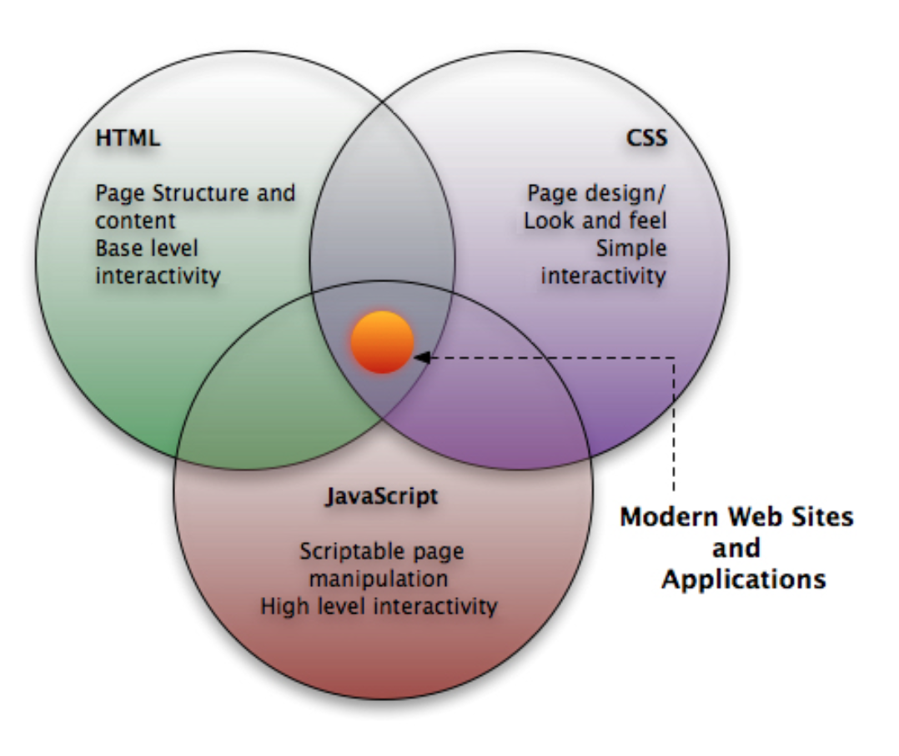
Connect Web-based Client to Application
https://alineinfo.wordpress.com/2012/02/20/para-que-serve-o-javascript/

Slide 14
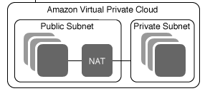
AWS Tutorials
Everything that you need to know about AWS has been posted
Please follow-up and review tutorial videos and the code base
λ
RDS

Slide 15
Live Demonstration in AWS console
Key services
Lambda function
API Gateway
S3 Bucket
RDS
Development Services
Cloud9
Cloudwatch

Slide 16
Task 2
Design Application for Cloud-Based System Due Tuesday Oct 11th
First part
Complete tutorial “AWS Instructions” for creating a calculator that adds two numbers together
Replicate what I have done in your own account
Second part
Given knowledge gained from First part, design the API of your Inventory Management System application
Gold Standard use cases published to Canvas

Slide 17
How to define valid JSON strings
For this assignment, you will provide sample strings and their sample responses
Similar to petstore
[ { "id": 1, "type": "dog", "price": 249.99 }, { "id": 2, "type": "cat", "price": 124.99 }, { "id": 3, "type": "fish", "price": 0.99 }
]

